Slide 1



Chapter 7
T. Trimpe http://sciencespot.net/

Slide 2
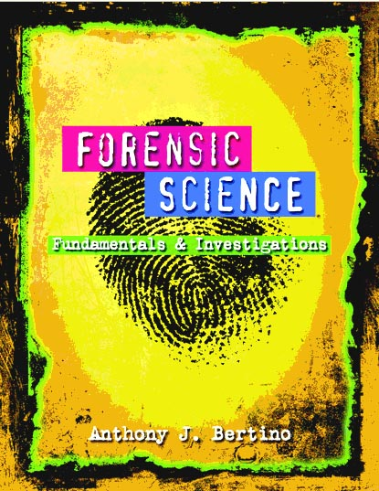
Chapter 7 DNA Analysis
By the end of this chapter you will be able to:
Project: Case Study Book Report
Explain how crime scene evidence is
collected and processed to obtain DNA.
Extract DNA and know extraction protocol.
Explain how DNA evidence is compared for matching (process of electrophoresis)
Describe how radioactive probes are used in DNA fingerprinting
Explain how to use DNA fingerprinting to identify DNA from a parent, child, other relative, or a non-related individual
All Rights Reserved South-Western / Cengage Learning © 2012, 2009
Forensic Science: Fundamentals & Investigations, Chapter 7

Slide 3
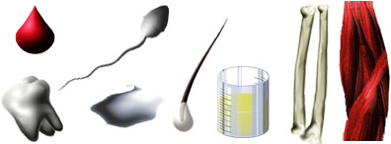
Sources of DNA from CS
Evidence is collected at the crime scene:
Blood Tissue
Semen
Urine
Hair
Teeth Saliva Bone
Notes:
What kinds of evidence contain DNA?

Slide 4
DNA Evidence
DNA fingerprinting is an Individual evidence.
If found in trace amounts, Polymerase chain reaction (PCR) technique can generate multiple copies of DNA evidence.
Several factors can affect the DNA left at a crime scene, such as environmental factors (e.g., heat, sunlight, moisture, bacteria, and mold). Therefore, not all DNA evidence will result in a usable DNA profile. Further, DNA testing cannot identify when the suspect was at the crime scene or for how long.
Forensic Science: Fundamentals & Investigations, Chapter 7

Slide 5
Collection and Preservation of DNA
Use disposable gloves and collection instruments
Avoid physical contact, talking, sneezing, and coughing in the evidence area
Air-dry evidence and put it into new paper bags or envelopes (Dry or freeze the evidence)
Keep evidence cool and dry during transportation and storage
Forensic Science: Fundamentals & Investigations, Chapter 7

Slide 6
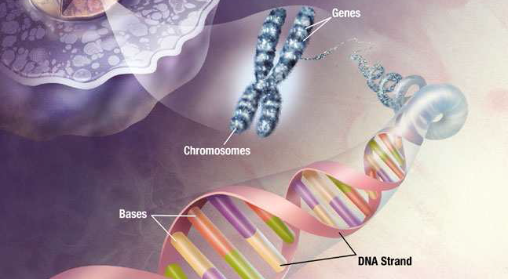
Cell and DNA – where is DNA?
Forensic Science: Fundamentals & Investigations, Chapter 7

Slide 7
Extraction of DNA
Collect/Harvest cells (chew the sides of your mouth to collect cheek cell)
Add soap/salt solution to break open the cell membrane.
Add protease (enzyme to digest the protein)
Add ethanol (DNA water soluble so to make it visible, alcohol is added).
Run PCR if only trace amount found.
Forensic Science: Fundamentals & Investigations, Chapter 7

Slide 8
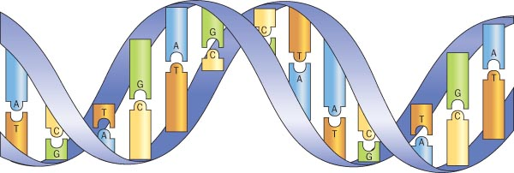
The Function and Structure of DNA
DNA contains the genetic material and is in the cell’s nucleus
Chromosomes is long DNA strands wrapped around proteins
DNA is composed of nucleotide units which has deoxyribose sugar, phosphate, and nitrogenous base.
Nitrogenous Bases—pairs of molecules that form the rungs of the DNA “ladder”
  A binds with T
  C binds with G
  These base pairs forms an unique sequence in each individuals
Forensic Science: Fundamentals & Investigations, Chapter 7

Slide 9
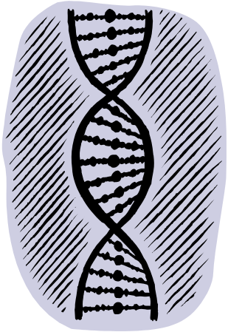
Did you know?
Each human cell contains 23 pairs of chromosomes which is three billion DNA base pairs long.
Cannot look at the entire sequence. Too long so we only look at 13 places.
DNA information : http://www.dna.gov/audiences/investigators/know/

Slide 10
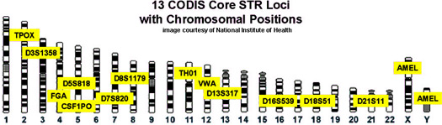
13 core CODIS loci
Combined DNA Index System – database of DNA obtained from crime scenes and violent offenders.
CODIS examines 13 loci or markers that are uniformly distributed across the human genome.
13 loci are chosen so they reveal no medical or health information, hence, they are also called “anonymous” marker.

Slide 11
DNA Identification
In analyzing 13 loci, that particular location is cut from the chromosome using restriction enzyme.
Polymorphisms: Non-coded DNA that contain unique patterns of repeated base sequences that are unique to individuals.
Short Tandem Repeats (STR) compared.
Example:
#1: ACG ACG ACG ACG
#2: ACG ACG ACG ACG ACG ACG ACG ACG
Forensic Science: Fundamentals & Investigations, Chapter 7

Slide 12
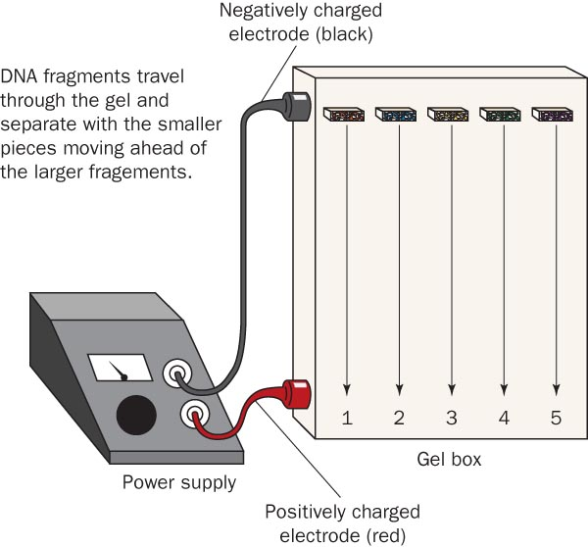
Electrophoresis
DNA samples are placed in gels through which electronic currents are passed
DNA fragments line up in bands along the length of each gel.
Arrows show the movement of the negatively charged DNA fragments through the gel matrix
Forensic Science: Fundamentals & Investigations, Chapter 7

Slide 13
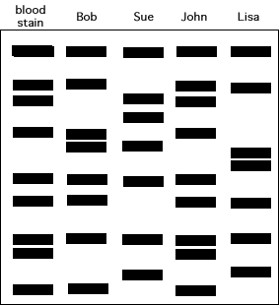
DNA Profiling/Fingerprinting
It is analyzed for
  tissue matching
  (Two samples that have the same
  band pattern are from the same
  person)
  inheritance matching
  (Each band in a child’s fingerprint
  must be present in at least one
  parent)
More repeats, longer DNA strand
So stays close to the well.
Forensic Science: Fundamentals & Investigations, Chapter 7

Slide 14
Analysis of DNA
Additional Applications
DNA fingerprinting can
  match crime scene DNA with a suspect
  determine maternity, paternity, or match to another relative
  eliminate a suspect
  free a falsely imprisoned individual
  identify human remains
Forensic Science: Fundamentals & Investigations, Chapter 7

Slide 15
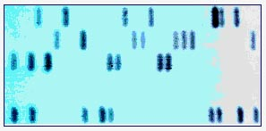
Probes
-more narrowing down
DNA probes
  identify the unique sequences in a person’s DNA
  are made up of different synthetic sequences of DNA bases complimentary to the DNA strand
  bind to complimentary bases in the strand (see the fragmentary DNA bands above)
In most criminal cases, 6 to 8 probes are used
Forensic Science: Fundamentals & Investigations, Chapter 7

